Slide 1

Notes:
“Good afternoon everyone”
“Good afternoon (Person leading assembly)”
“It is time for assembly”
Everybody to sing: Assembly time again….

Slide 2
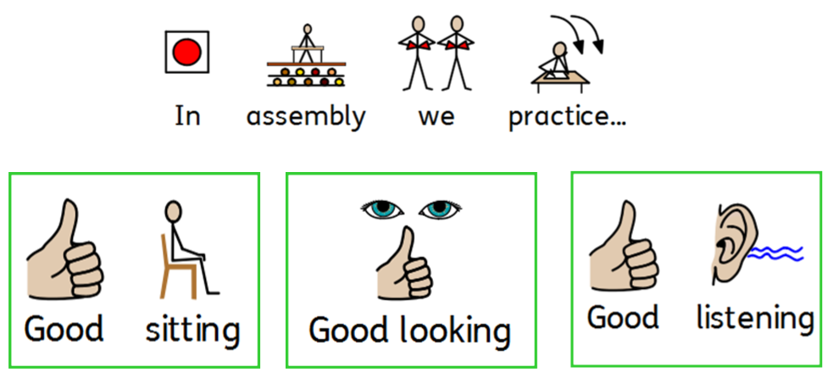
Notes:
Share these expectations and rules

Slide 3
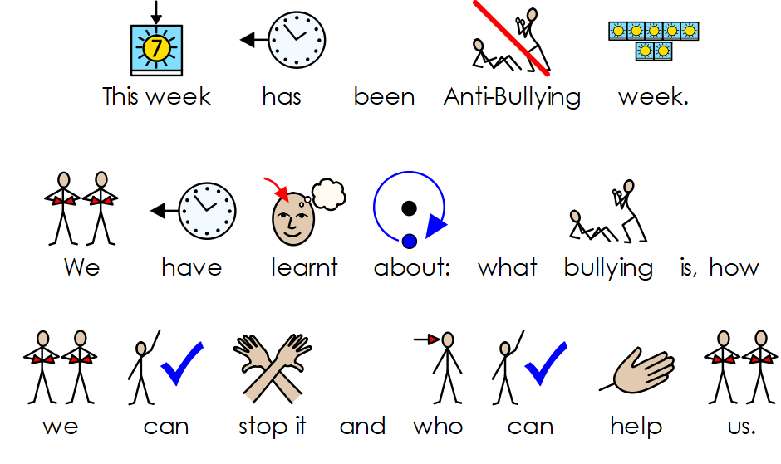

Slide 4

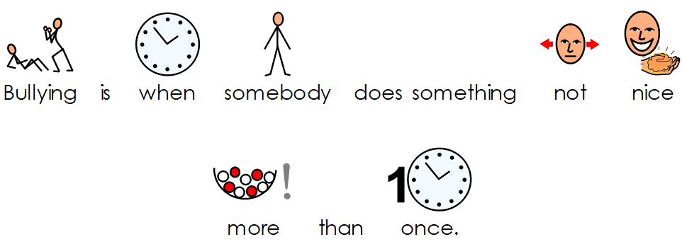
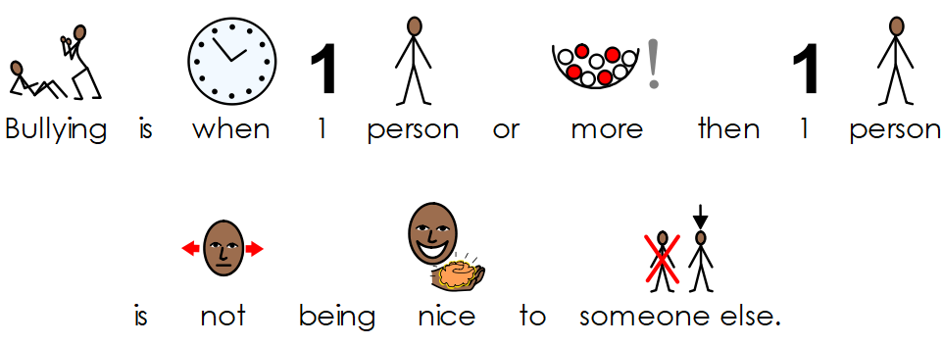
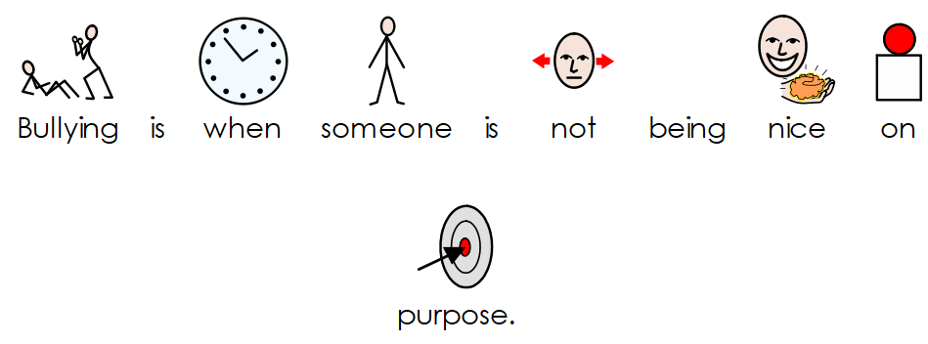

Slide 5
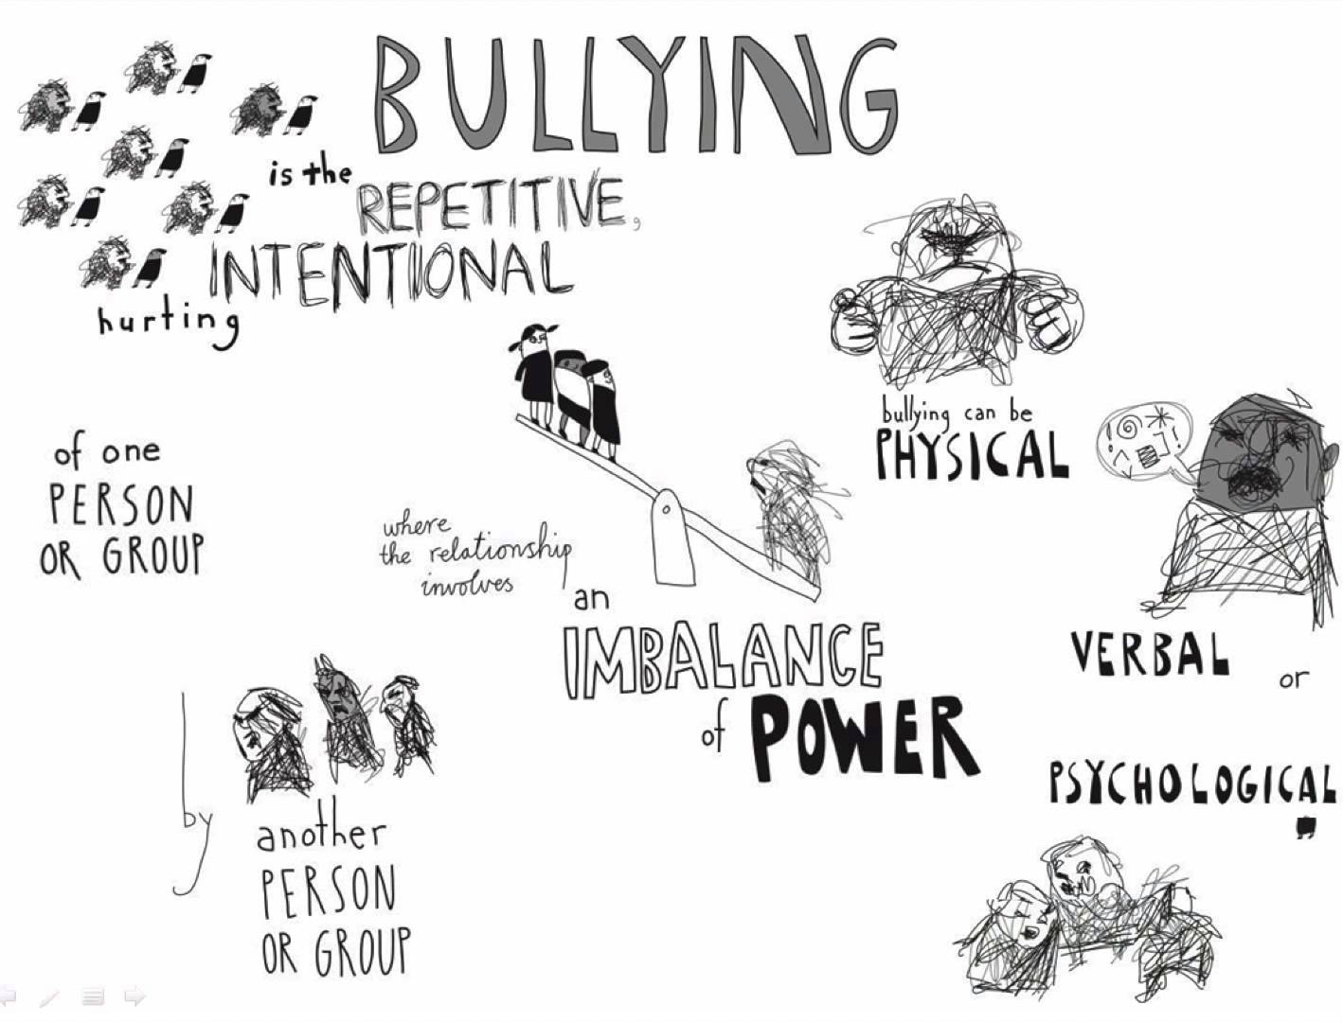

Slide 6
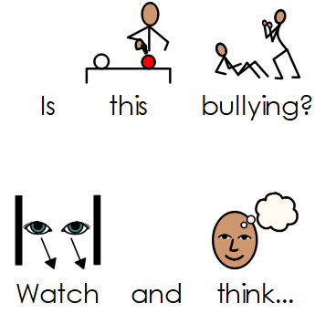
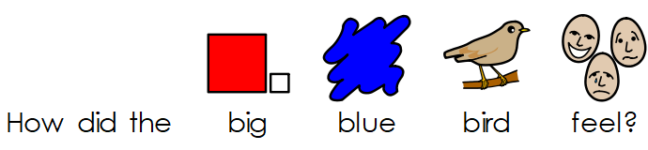
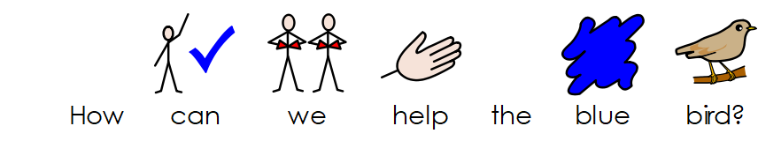
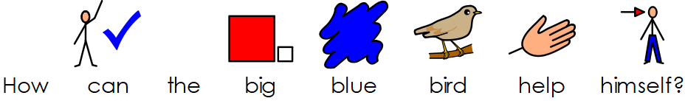

Slide 7
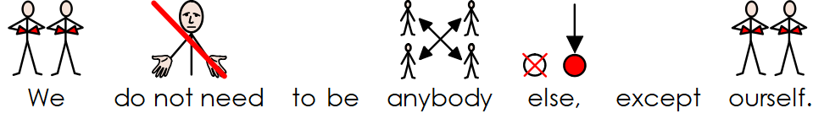
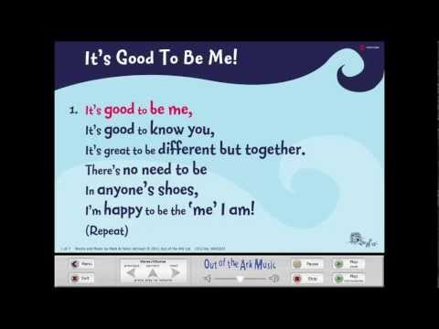

Slide 8

Click me!!

Slide 9

Notes:
Listen to some calm relaxing music.
Encourage all (staff and pupils) to reflect

Slide 10

Notes:
Star of the week
Work of the week
Wow work
Merits
Special achievements
Etc….

Slide 11

Notes:
Pupils and staff

Slide 12

Notes:
Praise good behaviour etc.
“Assembly has finished, time to say goodbye”
Everybody to sing: Good class (name) it is time to go…

