Slide 1


Rosehill School
Curriculum Project
100 Hearts Project

Slide 2

Key Learning Objectives
At the end of the Project pupil will develop:
An awareness of the importance of remembering others
Community participation skills and working as a team to produce a collaborative piece of art work
An understanding about different emotions and feelings
Language to talk about Coronavirus and the past year
School Development Plan Links:
Help pupils to develop the resilience to cope with change and to overcome adverse circumstances (wellbeing, health and mental health needs)
Increase the impact of Pupil Voice in contributing to the development and work of the school and wider community

Slide 3
Project Content
Rosehill School have been invited to participate in a community event by making hearts out of craft and art materials.
Each heart represents someone in Nottingham who has sadly lost their lives to Covid19 in 2020/2021. It is a chance to reflect on how this year has altered so many things for us all. How our lives have changed and how through it all we have lots of different feelings.
In this project, pupils will be reflecting on the year and how Coronavirus has changed their worlds. The pupils will have the opportunity to respond creatively to the stimulus- an introduction about the project and an interactive smart board presentation based on a story about the different emotions we feel in our heart. This story uses colour to visualise emotions.

Slide 4
Impact on children and young people
Engagement-
Classes that participated in the tasks enjoyed the chance to be reflective.
All pupils that joined in with the project had the opportunity to develop their emotional literacy through engaging in text that broadens vocabulary and understanding.
Pupils are taking part in an ongoing piece of collaborative community art work.
Pupils were given the opportunity to verbalise through words, symbols, and art their emotions and feelings.

Slide 5
Impact on staff/school community
Staff have been able to talk about emotions and feelings with the pupils- we all have feelings too. Developing empathy and relationship.
The school involved in the wider community.
It is exciting to see what the finished project will look like and pride to know we took part.

Slide 6
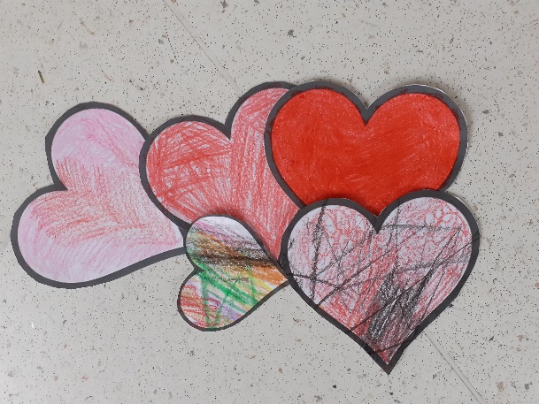
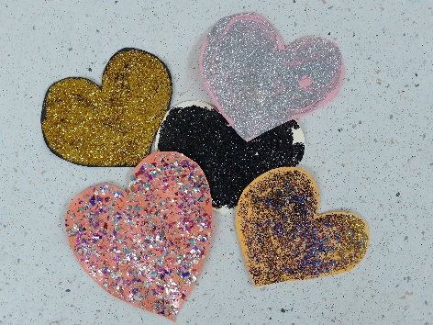
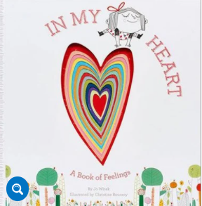
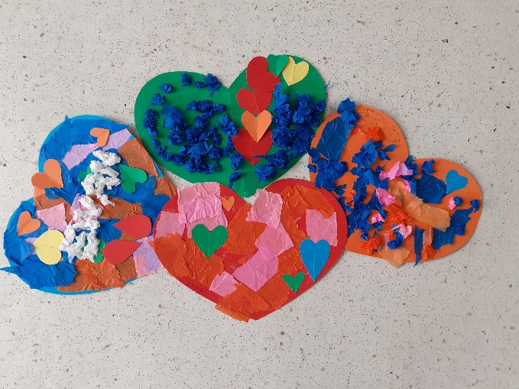
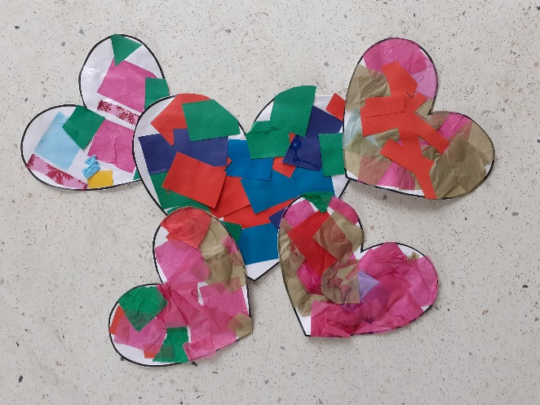
Impact of our project through photographs
Collage and different materials used by pupils to represent emotions
Powerpoint of story ‘In my heart’ shared with staff as a resource
Message from Andy Jenkins the organiser to encourage staff
‘As a recently retired head Nottingham City head teacher, please accept and pass on my thanks for everything you are doing for your pupils and community at the moment – Rosehill is a special place.’

Slide 7
Next steps
Continue providing opportunities for all pupils to be involved in community projects
1
Continue the conversation about emotions and feelings particularly in the current Coronavirus climate
2
Continue to use creative ways to express our feelings
3

